Slide 1
N-Tuple Bandit Evolutionary Algorithm (NTBEA) for Game Agent Optimisation
Simon Lucas¹, Jialin Liu² and Diego Perez¹
1: Queen Mary University of London
2: Southern University of Science and Technology, Shenzhen
Short-listed for an IEEE CEC 2018 Best Paper Award

Slide 2
Motivation: Sample-Efficient Algorithm Tuning for Noisy Problems
The difference between a well-tuned and poorly tuned algorithm or agent can be enormous
All too often, tuning is left down to the expertise of the researcher
But this expertise may be in limited supply, or out of date, or time-consuming to apply
knowledge sometimes becomes stale: remember when 2 hidden layers was enough for any application!
Best practice is to use an automated approach in addition to any manual tuning
Notes:
The problem we tackle is sample-efficient algorithm tuning, also known as hyper-parameter optimisation. The difference between a well-tuned and poorly tuned algorithm or agent can be enormous, but tuning is often done manually, There is growing evidence that automatic tuners can offer better performance with less effort. So it is best practice to use an automated approach, perhaps in addition to any manual tuning. [26s]

Slide 3
Main contributions
NTBEA is a new algorithm for noisy parameter optimisation (see our CEC 2017 paper [2])
The algorithm is efficient, effective and informative
We apply it to tune a rolling horizon evolution agent
And boost performance of this General Game AI algorithm
When properly tuned it often beats Monte Carlo Tree Search
Using NTBEA we found that long playout lengths in combination with using a shift buffer are key to good performance, also high mutation rates
Notes:
[45s]

Slide 4
NTBEA involves several concepts: here we use it to tune a RHEA
EDA
CMAB
NTBEA
EA
RHEA
Notes:
NTBEA is a type of Estimation of Distribution Algorithm, or EDA. This is a kind of Evolutionary Algorithm that uses a model of a population instead of or as well as an actual population. NTBEA still uses a standard EA but does most of the search in the space of a learned model. The model is similar to a combinatorial multi-armed bandit, or CMAB. Here we use it to tune a RHEA, so these are the main concepts involved in this paper. [35s]

Slide 5
Relationship to other models
N-Tuple Bandit EA
Similar to Combinatorial Multi-Arm Bandit (CMAB)
Evolutionary algorithm adds more focused search to bandit sampling process
Bandits: what do they add?
Explicit control of exploitation / exploration dilemma
Natural escape from local optima

Slide 6
NTBEA: block diagram
Note the fat connection between the EA and the landscape model
N-Tuple Bandit Fitness Landscape Model
Noisy Fitness Evaluator
(Algorithm to be tuned)
Evolutionary Algorithm
Notes:
The block diagram shows the main system architecture. It is pretty simple. In the middle we have an almost standard evolutionary algorithm. The noisy fitness evaluator is the system it is trying to optimise - in this case each evaluation involves an agent playing through a stochastic game. On the left we illustrate the EA making many accesses to the bandit landscape model. It uses this surrogate model to improve sample efficiency.

Slide 7
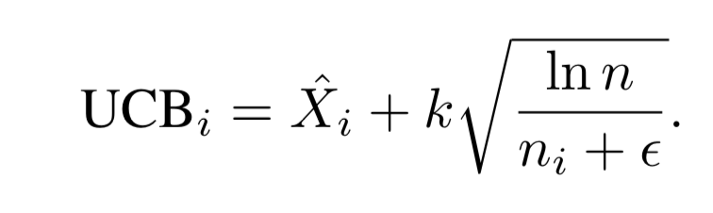
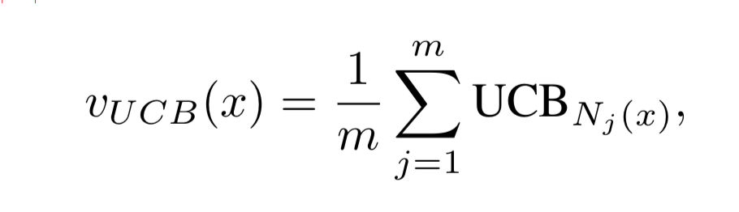
Bandit Equations
Multi-Armed Bandit
Combining Multi-Armed Bandits (simple average)
In this paper m=16
Notes:
Note the use of epsilon

Slide 8
Let’s now consider a Multi-Armed Bandit to tune a single parameter

Slide 9
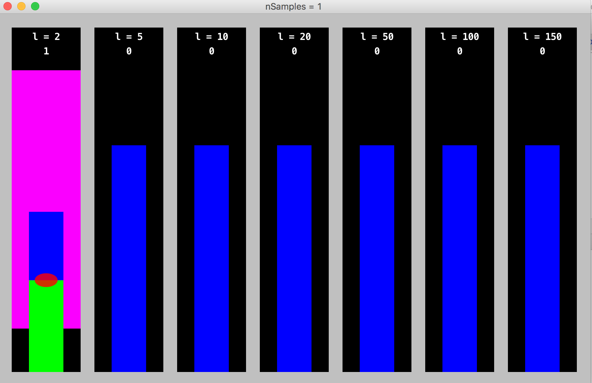
Start with a random param value Evaluate and add to model

Slide 10
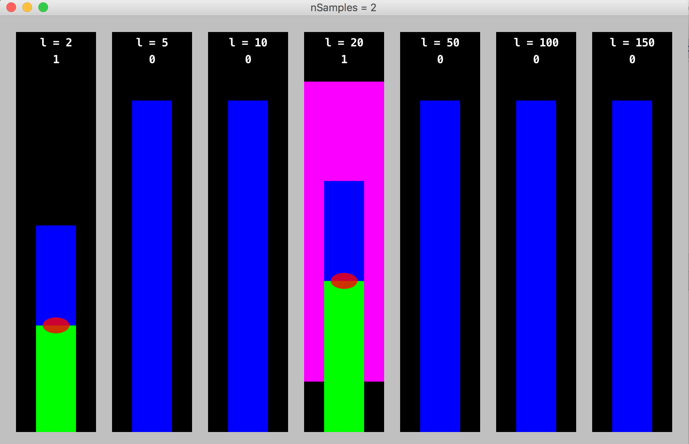
Green bars: exploitation Blue bars: exploration Green + Blue = UCB value

Slide 11
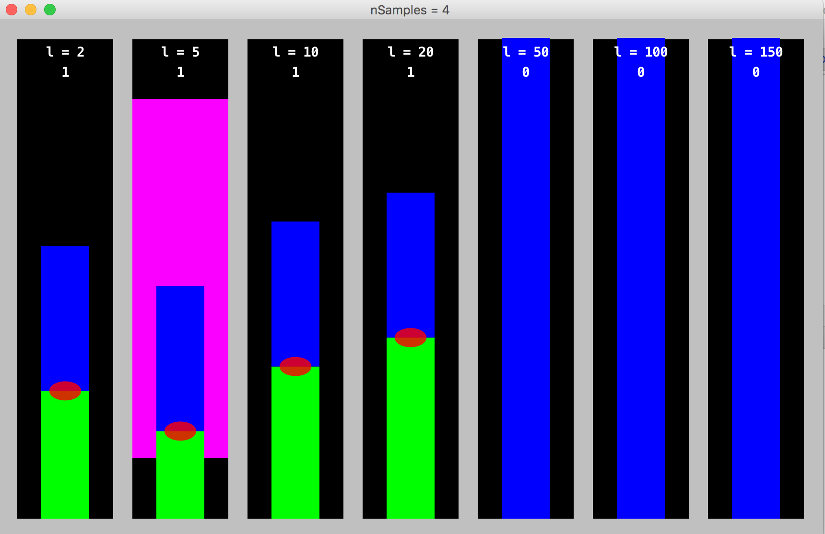
Note how exploration term grows for less sampled options

Slide 12
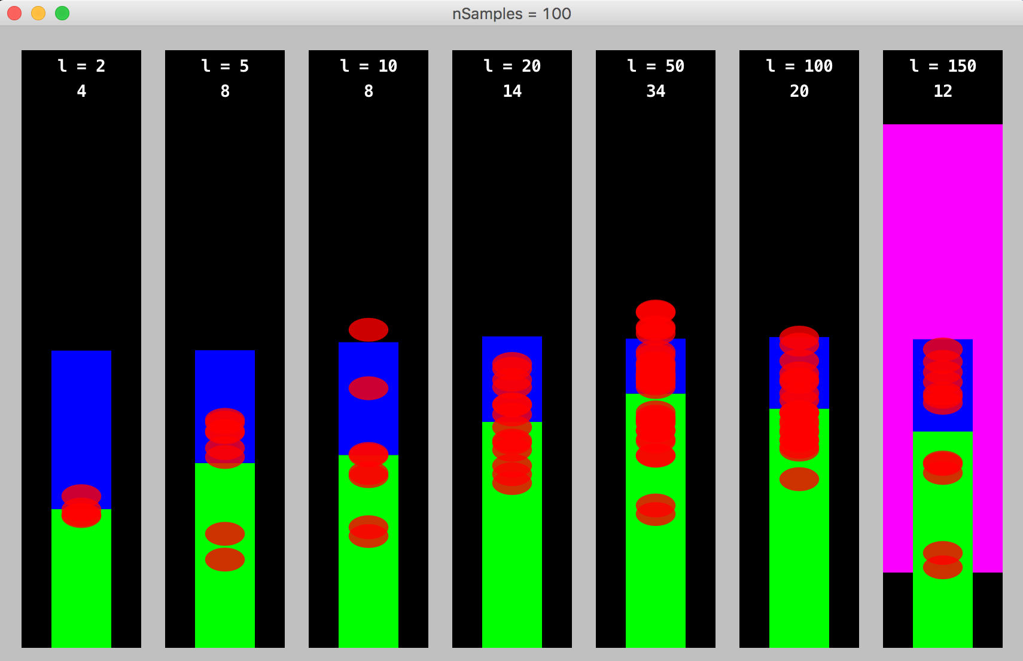
Note how promising options are sampled more frequently

Slide 13
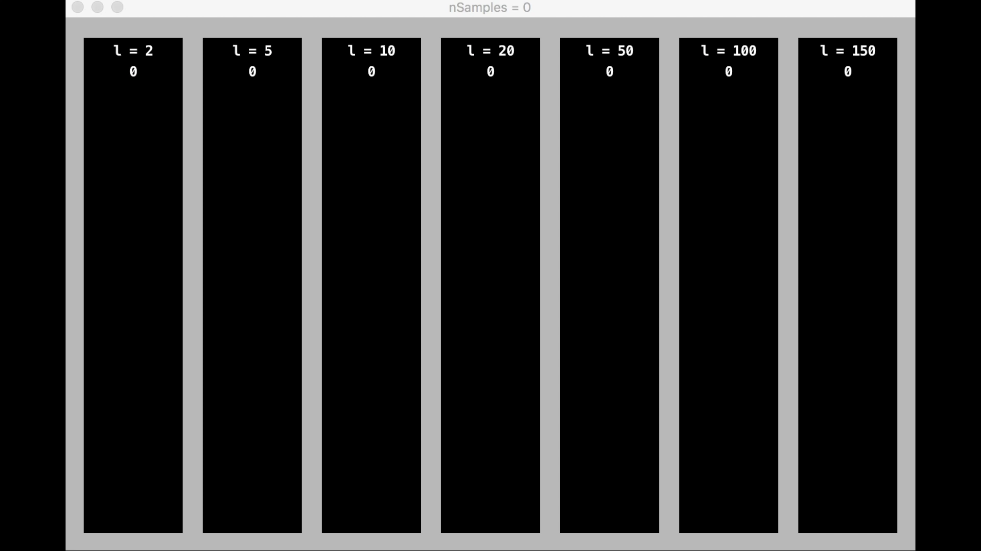
Video
15000
0

Slide 14
So far, that’s fine for a single parameter
But we need to choose the best COMBINATION of parameters!
Hence the N-Tuple model
Scales well for a large number of parameters

Slide 15
N-Tuple Bandit Model: suppose we have P parameters to tune
1-Tuples: Each 1-tuple models a single parameter: there are P 1-Tuples
2-Tuples: Each 2-Tuple models each distinct pair of parameters: there are P(P-1)/2 2-tuples
N-Tuple: This models the effects of all parameter choices combined: there is 1 P-Tuple
In this paper we have 5 parameters to tune, hence 16 tuples (5 + 10 + 1).
N-Tuples are superfast compared to (for example) Gaussian Processes and give one-shot learning

Slide 16
The 16 tuples used (parameter indices)
[0],[1],[2],[3],[4]
[0,1],[0,2],[0,3],[0,4]
[1,2],[1,3],[1,4]
[2,3],[2,4]
[3,4]
[0,1,2,3,4]

Slide 17
A standard (1,lambda) EA
int[] p = random point in search space
while (evaluation budget remains) {
Picker picker = new Picker();
repeat for nMutations {
int[] m = mutate(p);
picker.add(m, evaluate(m));
}
p = picker.getBest();
}
return p;
Notes:
The NTBEA is most similar to a standard (1,lambda) EA. Let’s recap that this starts with a random point in the search space, then until termination
We repeat a series of variation, evaluation and selection operations. Note that all evaluations are done using the actual problem evaluator. The Picker object is a convenient type of Argmax function: it is there to Pick the mutated copy version with the highest value.

Slide 18
The NTBEA Algorithm
int[] p = random point in search space
model = new NTupleModel();
while (evaluation budget remains) {
double f = evaluate(p);
model.add(p,f)
Picker picker = new Picker();
repeat for nMutations {
int[] m = mutate(p);
picker.add(m, model.ucb(m);
}
p = picker.getBest();
}
return model.getBest();
Notes:
Note that the NTBEA is similar. The main difference is that all the mutations of the current point are evaluated by the model rather than the actual problem evaluator.

Slide 19
Rolling Horizon Evolution
Evolves sequences of numbers in real-time
These are interpreted as action sequences and simulated on a copy of the game
Game score may be used as the fitness function
Choose the sequence that leads to the best score, and take the first action
If using a shift buffer, then shift the sequence forward and add a random action to the end to seed the population for the next decision step of the game
Then repeat for each step / turn of the game
Notes:
[45s]

Slide 20
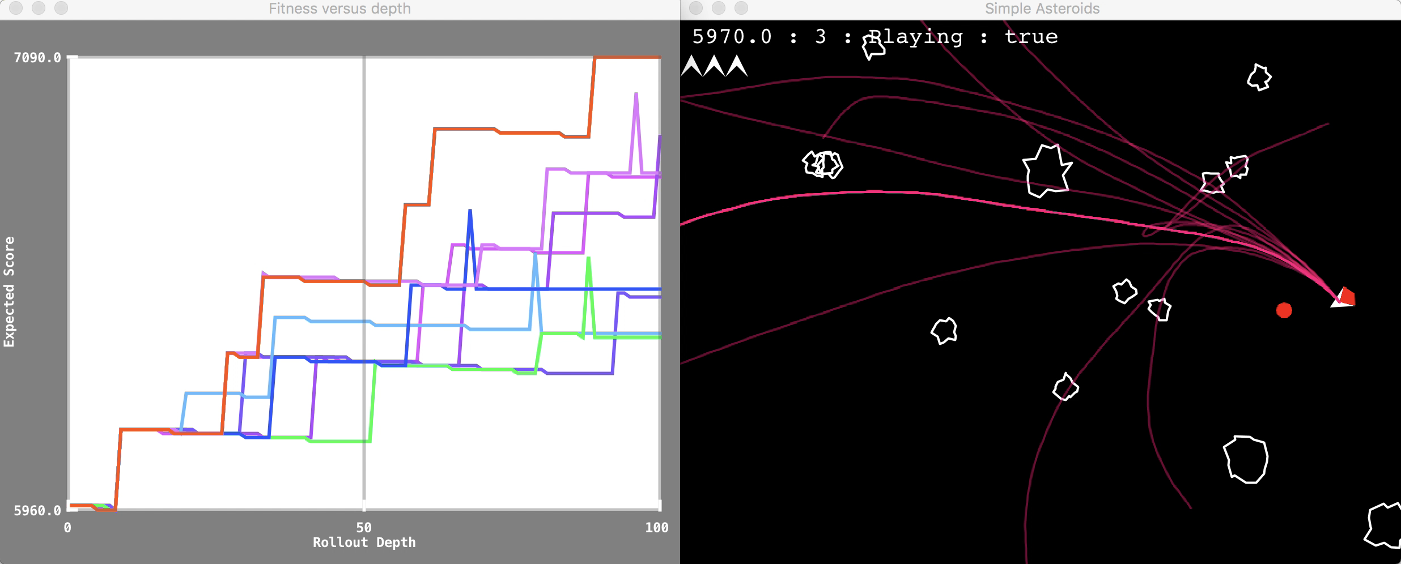
Rolling Horizon Evolution in Asteroids (each number corresponds to a joystick action)
Notes:
This shows a rolling horizon agent playing Asteroids. The graph on the left shows how the score varies with each game tick for each of the action sequences currently being evolved. This is looking 100 game ticks ahead from the current state. The screen shot on the right shows the current game state, with the pink lines showing the predicted ship positions for each of the action sequences on the left. [30s]

Slide 21
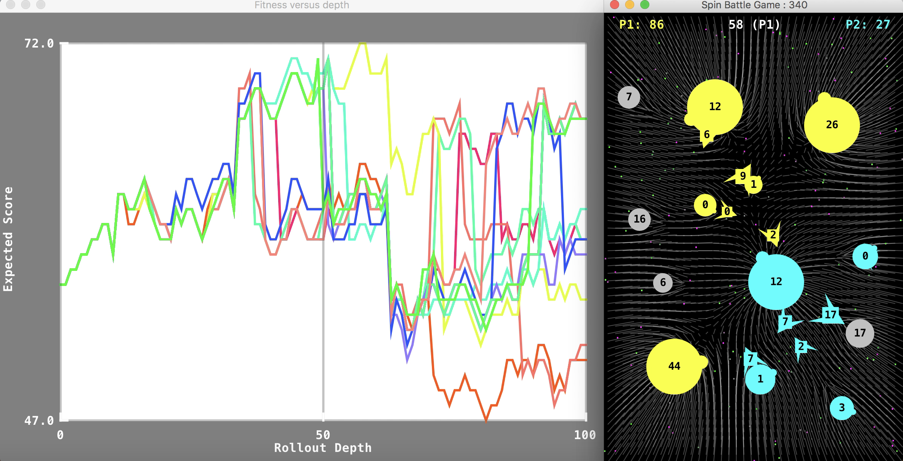
Rolling Horizon Evolution in Planet Wars (each number-pair specifies source and target planets for fleet transits)
Notes:
This is the same agent playing planet wars: a real time strategy game, and playing it very well. Rolling horizon evolution is a great approach for general game AI, and can be improved if we tune the parameters to best suit each game. Compared to Deep RL, rolling horizon evolution offers very rapid (instant) adaptation. [30s]

Slide 22
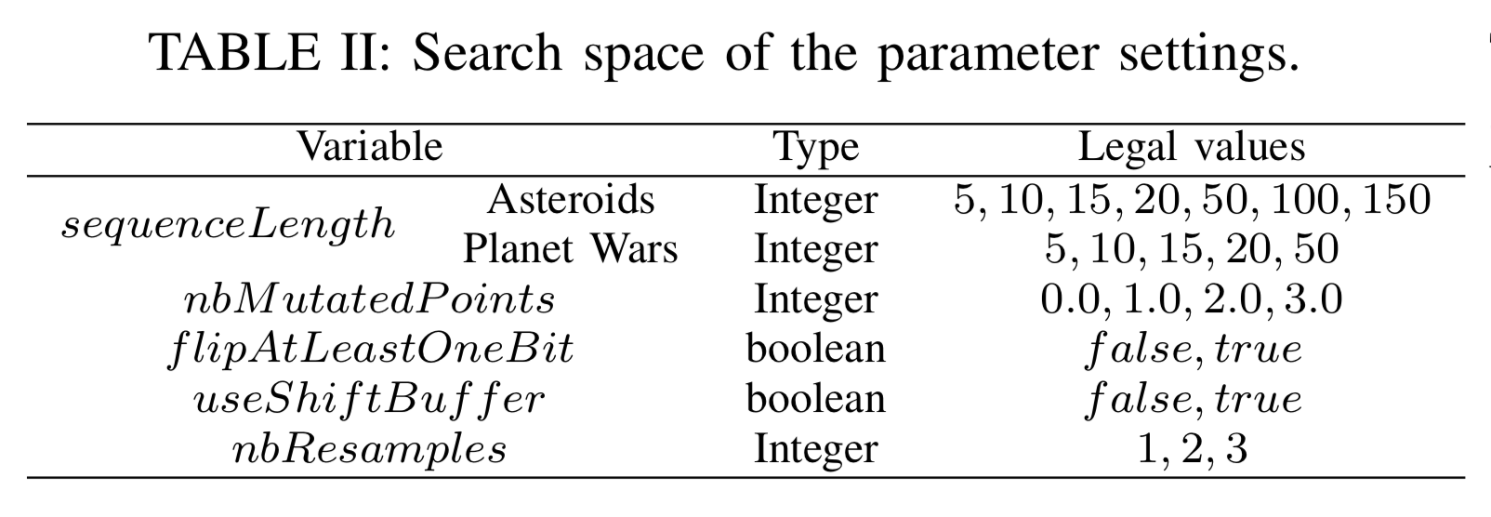
Parameters of a Rolling Horizon Evolution Agent

Slide 23
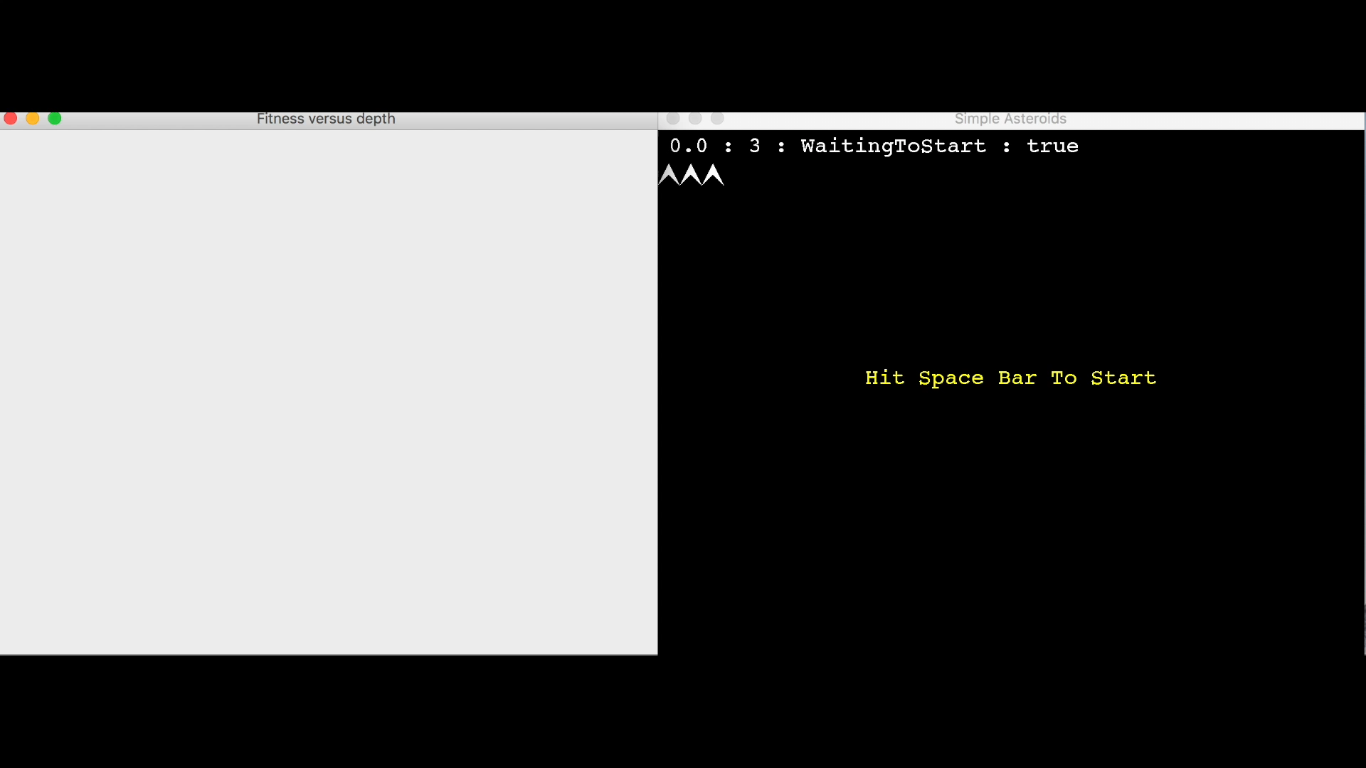
Poorly tuned agent (l=20, …)

Slide 24
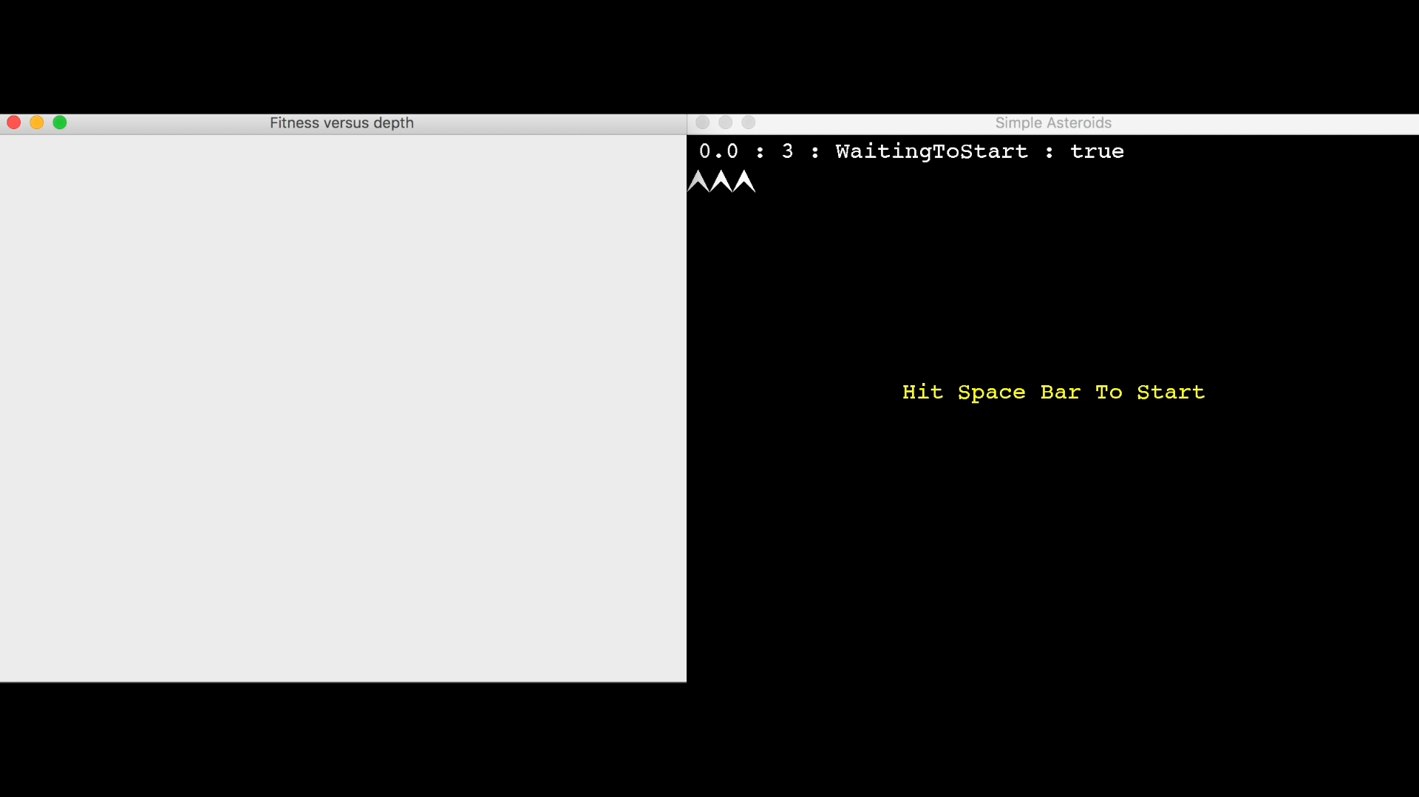
Well-tuned agent: (l=100, …)

Slide 25
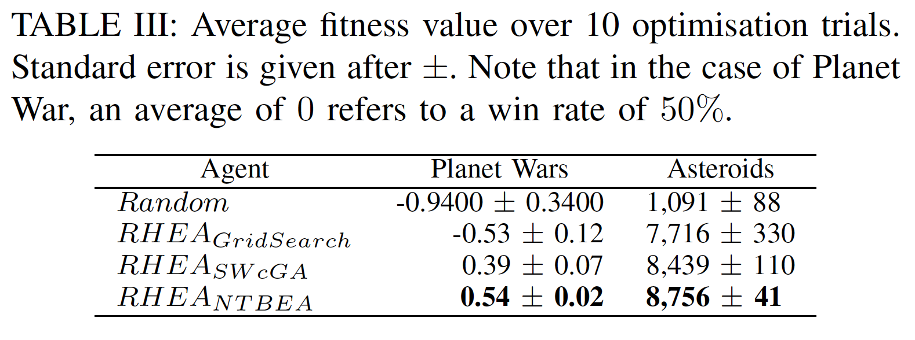
Results from paper

Slide 26
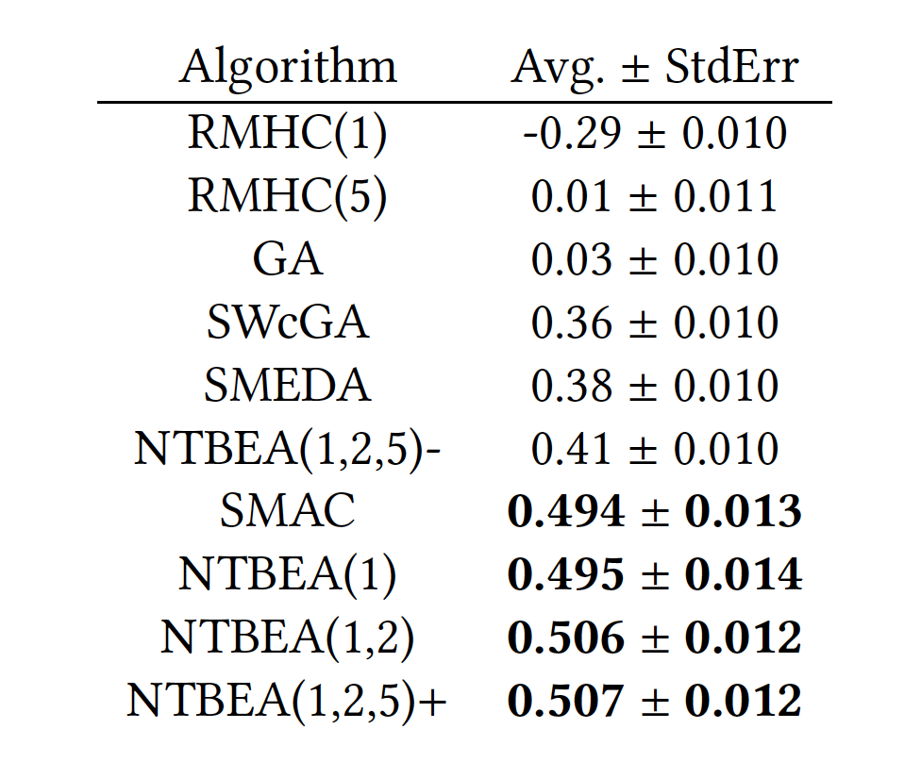
Extended Planet Wars Results (100 trials) SMAC = Sequential Model-based Algorithm Configuration [23]
Model based

Slide 27
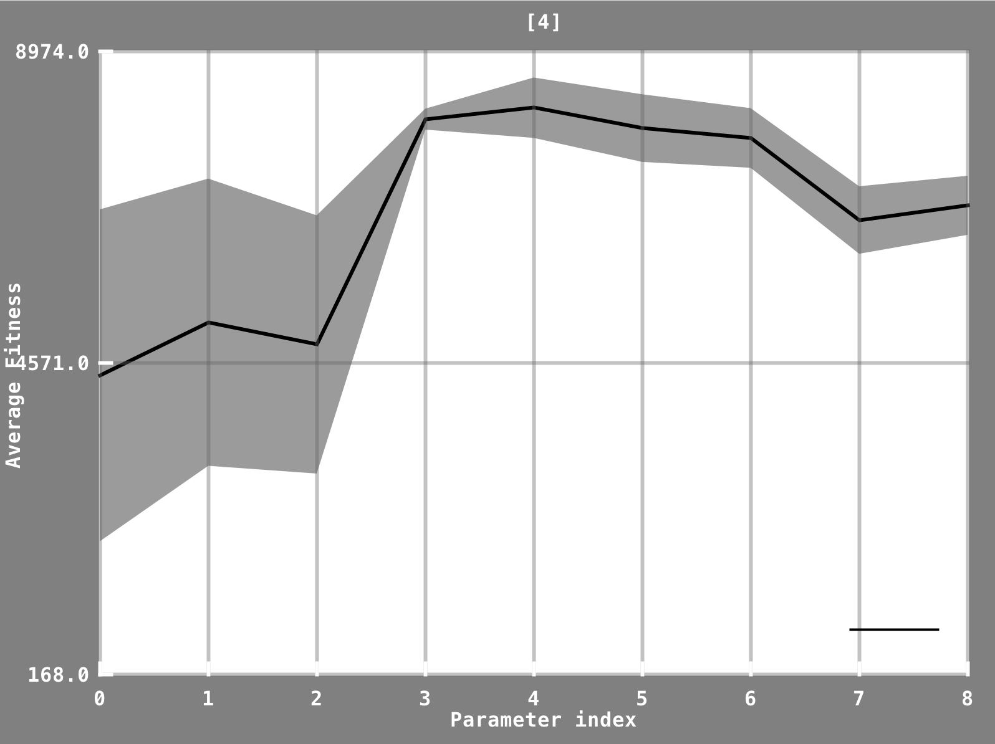
Informative model for each N-Tuple (e.g. 1-tuple below shows fitness versus v. sequence length)
Notes:
This shows the model of the sequence length parameter

Slide 28
Conclusions and Future Work
N-Tuple Bandit EA for noisy hyper-parameter optimisation: highly sample-efficient
Learn new things! (long seq. length, high mutation rates)
Competitive with SMAC, one of the leading algorithms for algorithm performance tuning
Simpler and more informative
Has already led to improved performance for our Rolling Horizon Evolution Agents
Future work
More applications, more comparisons
Analysis of nuances of why it works
Extending to continuous parameter ranges
Hierarchical parameters
Release of open-source software

Slide 29
Questions? Open source code on Github coming soon https://github.com/SimonLucas/ntbea

Slide 30
Hyper-Parameter Optimisation: Considerations
Parameter types:
Continuous, discrete, categorical
Flat versus tree structured / conditional
Robustness to Noise levels
From low to high, known versus unknown distributions
Efficiency
Space and time
Depending on number of samples (fitness evaluations), number of parameters / size of search space
Simplicity
Interpretability: how informative is the model?
System being optimised:
Black-box, grey-box, white-box (especially important is parameter sharing)
Is Early Stopping possible?
Available software (simplicity of APIs and operability)

